Slide 1
Module 3 Topic 3 Fuel cell types & applications

Slide 2
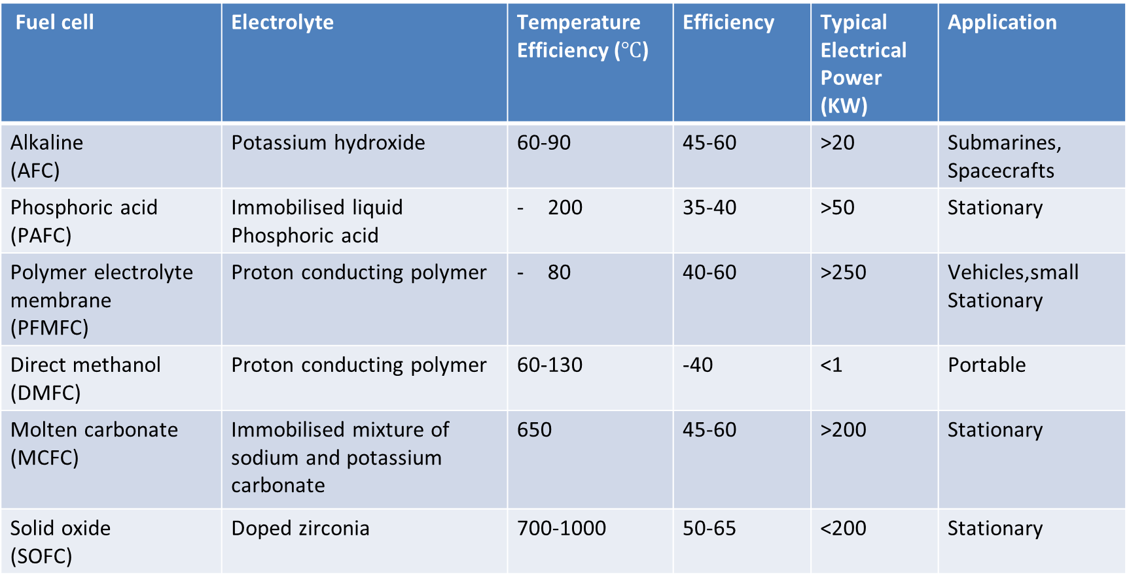
TYPES OF FUEL CELLS
Fuel cell | Electrolyte | Temperature Efficiency ($℃$) | Efficiency | Typical Electrical Power (KW) | Application
Alkaline (AFC) | Potassium hydroxide | 60-90 | 45-60 | >20 | Submarines, Spacecrafts
Phosphoric acid (PAFC) | Immobilised liquid Phosphoric acid | 200 | 35-40 | >50 | Stationary
Polymer electrolyte membrane (PFMFC) | Proton conducting polymer | 80 | 40-60 | >250 | Vehicles,small Stationary
Direct methanol (DMFC) | Proton conducting polymer | 60-130 | -40 | <1 | Portable
Molten carbonate (MCFC) | Immobilised mixture of sodium and potassium carbonate | 650 | 45-60 | >200 | Stationary
Solid oxide (SOFC) | Doped zirconia | 700-1000 | 50-65 | <200 | Stationary

Slide 3
APPLICATIONS OF FUEL CELLS
Application Type | Portable | Stationary | Transport
Definition | Units that are built into, or charge up, products that are designed to be moved, including auxiliary power units (APU) | Units that provide electricity (and sometimes heat) but are not designed to be moved | units that provide propulsive power or range extension to a vehicle
Typical power range | 5 kW to 20 MW | 0.5 kW to MW | 1 kW to 100 kW
Typical technology | PEMFC DMFC | MCFC PAFC PEMFC SOFC | PEMFC DMFC
Examples | - Non-motive APU - Military application - Portable products - Large personal devices - Education kits and toys | - Large stationary CHP Small stationary micro-CHP - UPS | - Forklifts - Cars & scooters - Trucks and buses

Slide 4
Thank you

